Slide 1

Lecture 9: What do helicopter and potato tell us about our past?

Slide 2

Lecture 10 & 11: Speak More Mandarin and Less Dialects

Slide 3
Why is SMC important to our understanding of Chinese Singaporean community?

Slide 4
Did the sociolinguistic situation in Singapore change drastically from 1819 to 1959?

Slide 5
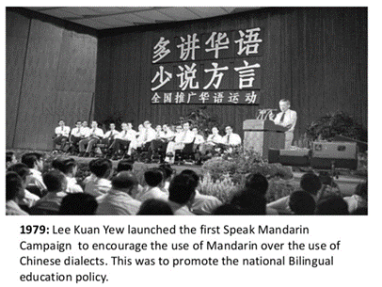
Speak More Mandarin and Less Dialects

Slide 6
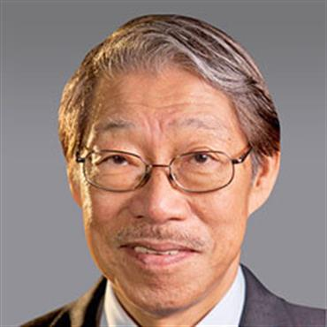

Slide 7
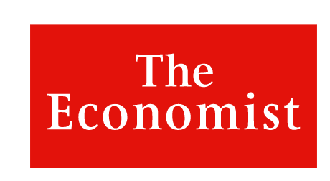

Slide 9
An ongoing campaign launched after independence for 40 years which has drastically changed the sociolinguistic profile of the Chinese Singaporean community

Slide 12
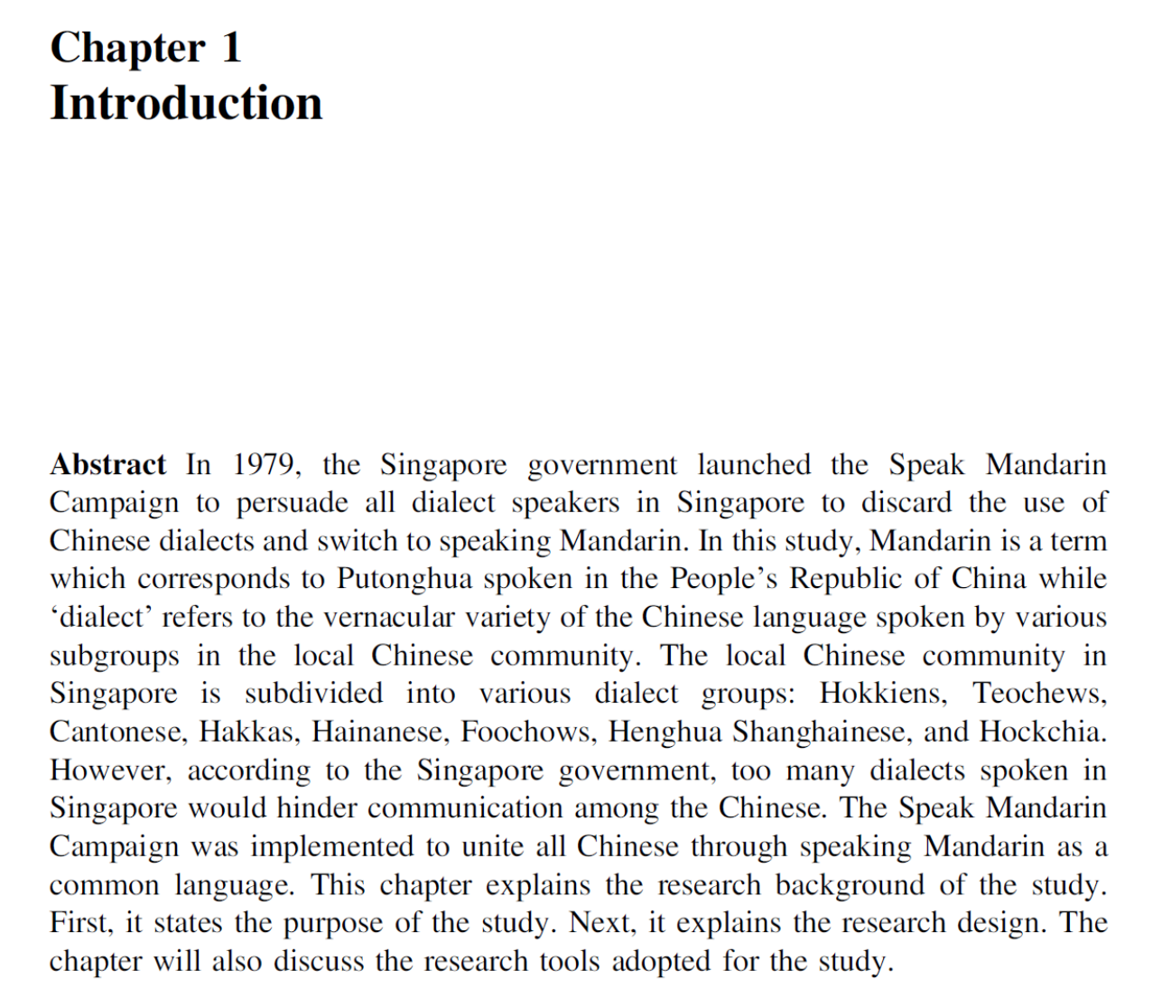

Slide 15
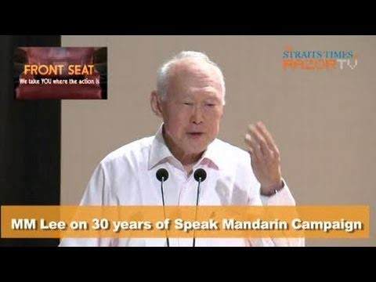

Slide 16
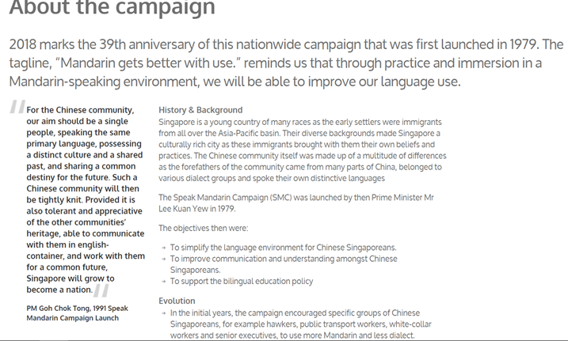

Slide 17
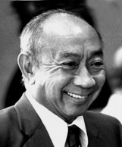
Report on the Ministry of Education (1978)
Goh Keng Swee (1918-2010)

Slide 19
Speak Mandarin Campaign and the bilingual education in Singapore

Slide 20
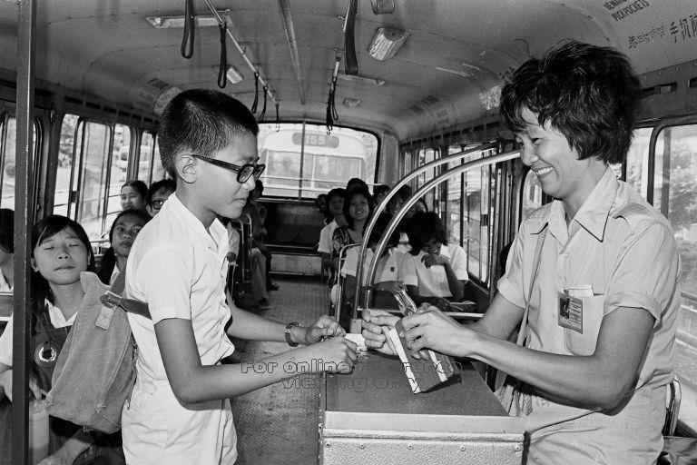
Typical Verbal Repertoire of a Chinese Singaporean in early Singapore

Slide 21
What was/were the mother tongue(s) of Chinese Singaporeans before 1979?

Slide 22
What is the definition of mother tongue?

Slide 24
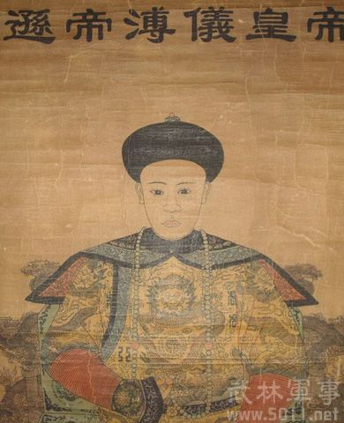
Can a non-Chinese has Chinese language as his/her mother tongue?

Slide 26
1980

Slide 27
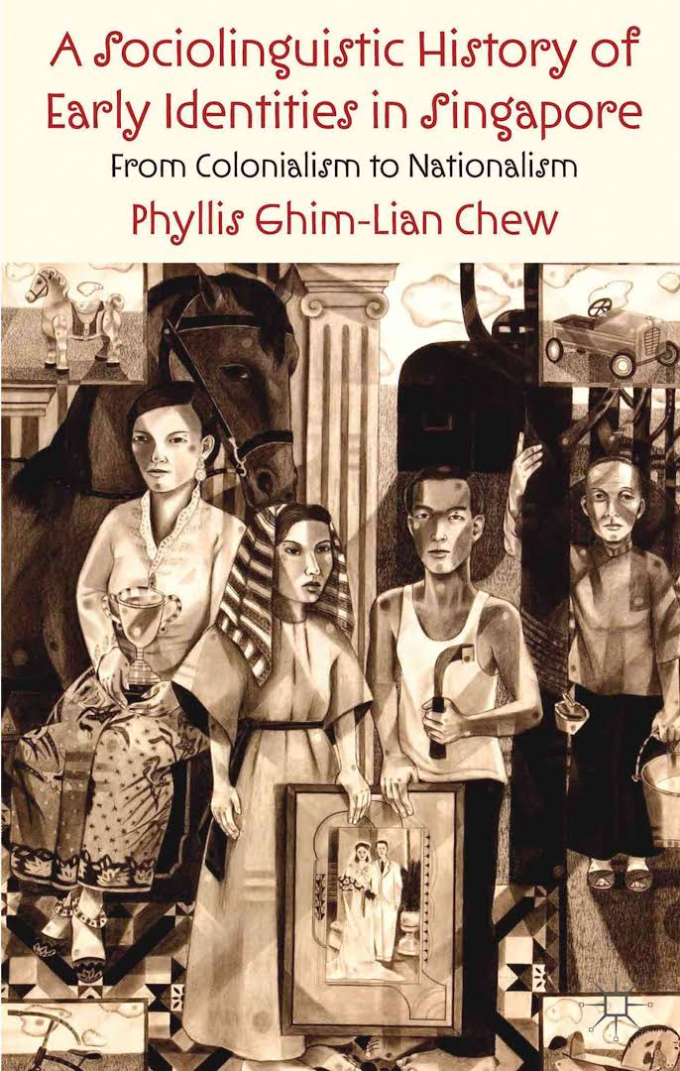

Slide 28
Languages that have a written and literary tradition and those that do not have

Slide 29
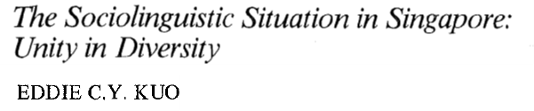
Was Mandarin the mother tongue of Chinese Singaporeans before 1979?

Slide 30
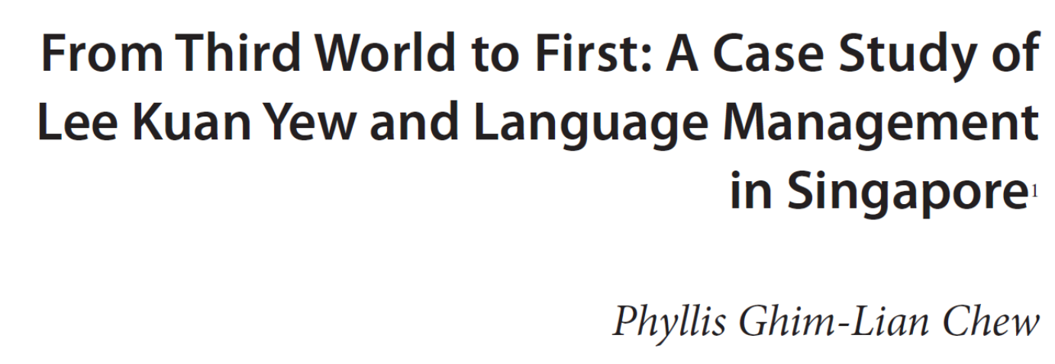
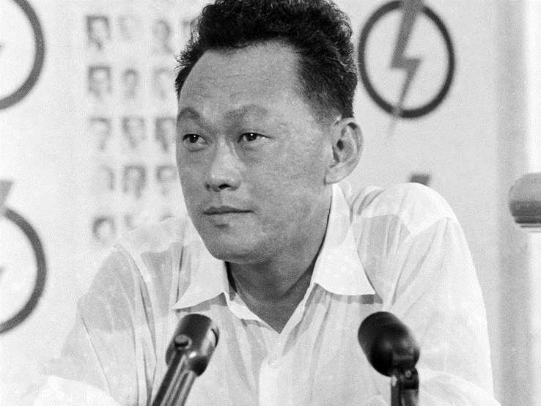
Was there any group within the Chinese Singaporean community whose mother tongue was English before 1979?

Slide 33
Education

Slide 34

THEN
19th and mid-20th centuries
British Colonial Rule

Slide 35
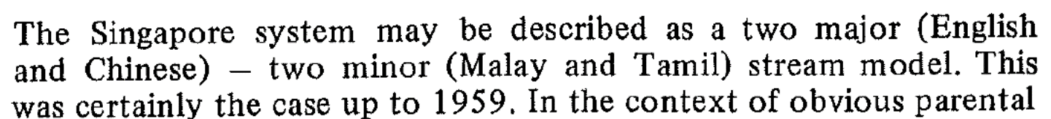
Schools in Singapore before 1959

Slide 38
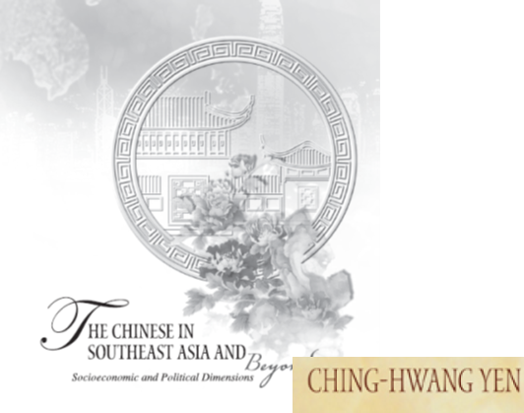
Vernacular schools
In Singapore, vernacular education refers to education conducted in the native languages of the main resident communities, namely Malay, Chinese and Tamil.

Slide 40
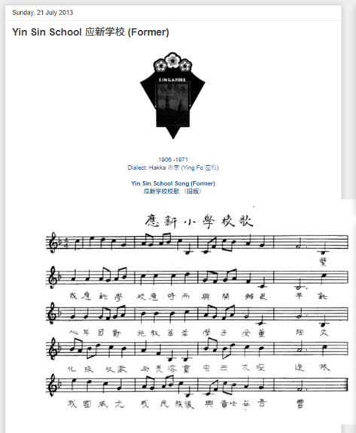

Slide 42
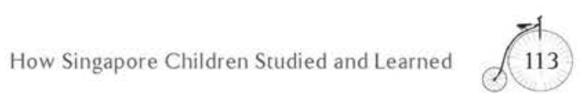

Slide 45
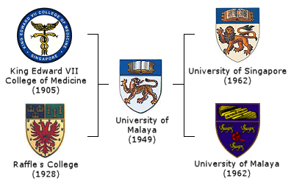

1956-1980

Slide 49
Chinese-medium and English-medium schools

Slide 52
Former journalist and diplomat Pang Cheng Lian, 72, who gathered the 21 writers for the book a year ago, said: "Many of my English-educated friends are considerably ignorant of the Chinese-speaking Singaporeans."

Slide 53

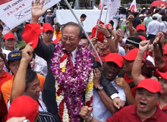
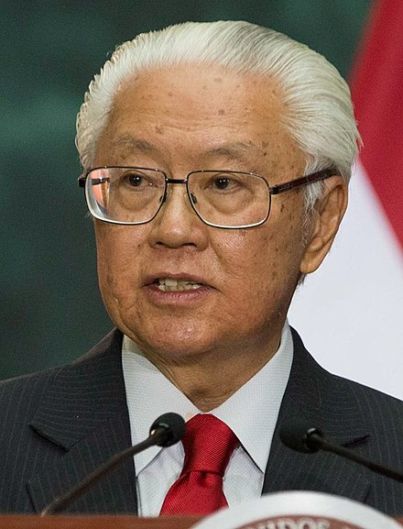
Chinese-educated vs English-educated

Slide 54
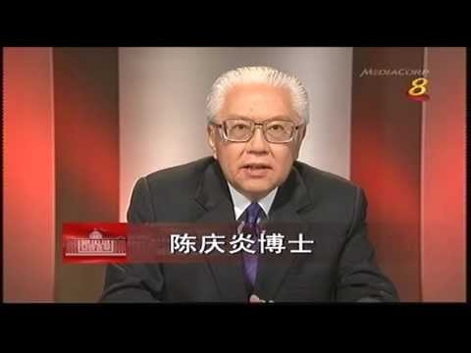

Slide 55
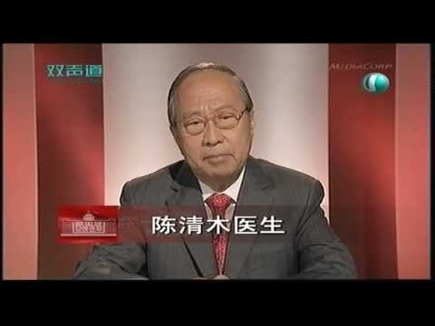

Slide 56
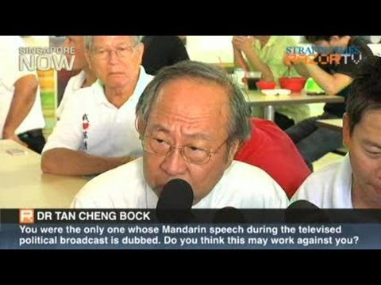

Slide 57
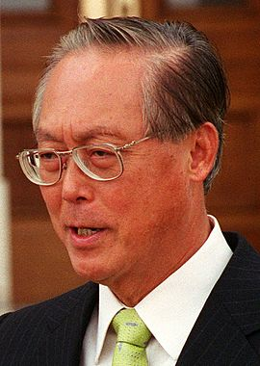
Aim to be one people, PM urges Chinese
1 Oct 1991
But community must be tolerant of others, work with them for the future; I speak Hokkien to my mother. My children speak to me and my wife in English, and Mandarin to their grandmother, my mother. They have dropped dialect. It will ...

Slide 58
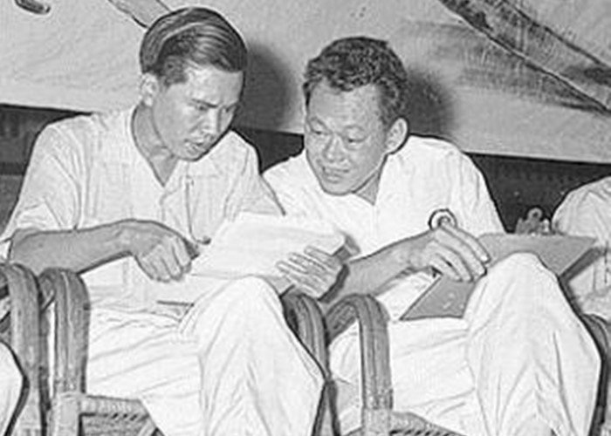
The PAP Story
1933-1996
1923-2015

Slide 59
Lim Chin Siong
Lim Chin Siong did well enough in his first semester at Catholic High that, together with an appeal from his father, he was able in 1950 to transfer to Chinese High School, then the premier Chinese medium school in Singapore. Lim was by then 17 years old, and distracted in his studies by numerous events: the victory of the Communists and the proclamation of the People's Republic; the African anti-colonial movement; and the ill treatment of students, particularly of Chinese descent, in Singapore.

Slide 60

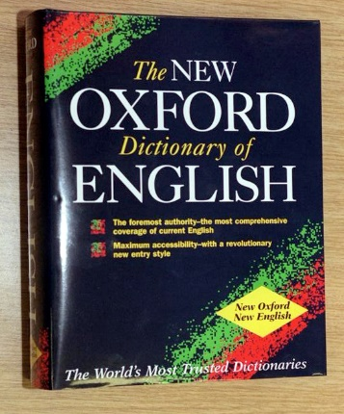
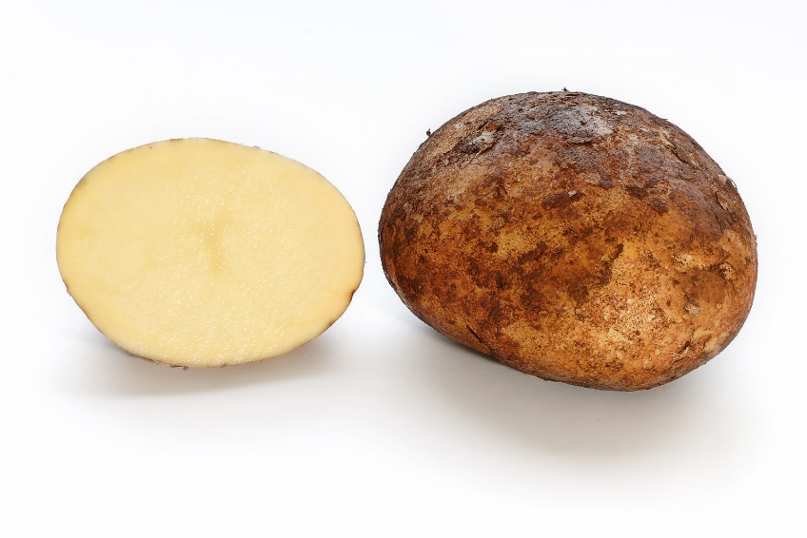
Chinese helicopter vs Jiak kantang

Slide 61
In her e-mail on Friday, seen by The Straits Times, Ms Tan, who now lives in Canada, said the term "had long degenerated into a label that equated Chinese-educated Singaporeans with inferior quality and low status in society. It was blatantly intended to belittle, humiliate and demean someone on the basis of his less fluent command of English".

Slide 62
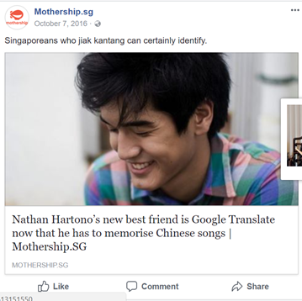

Slide 63
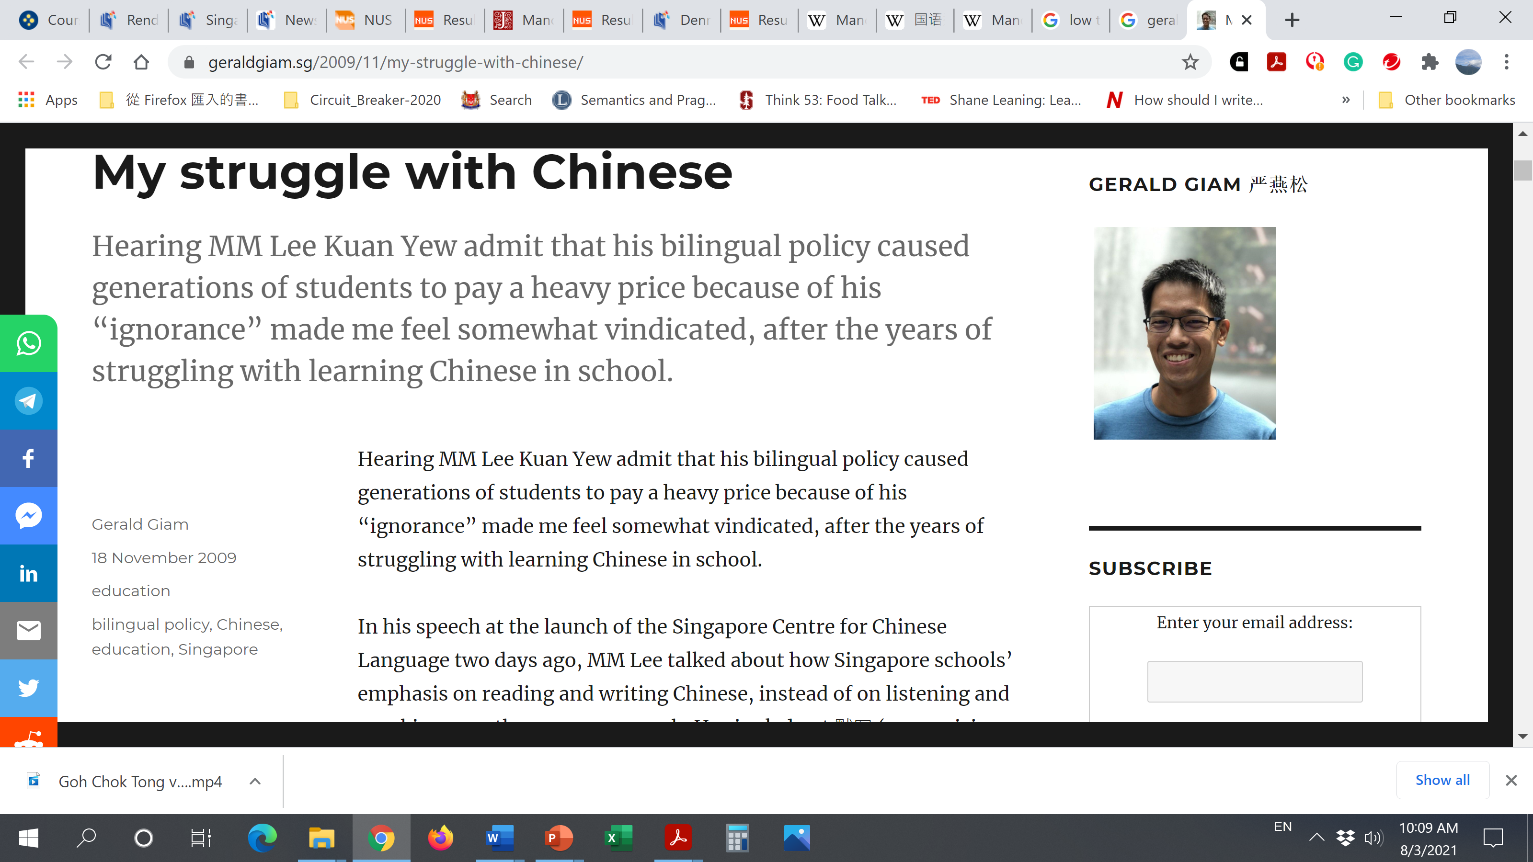
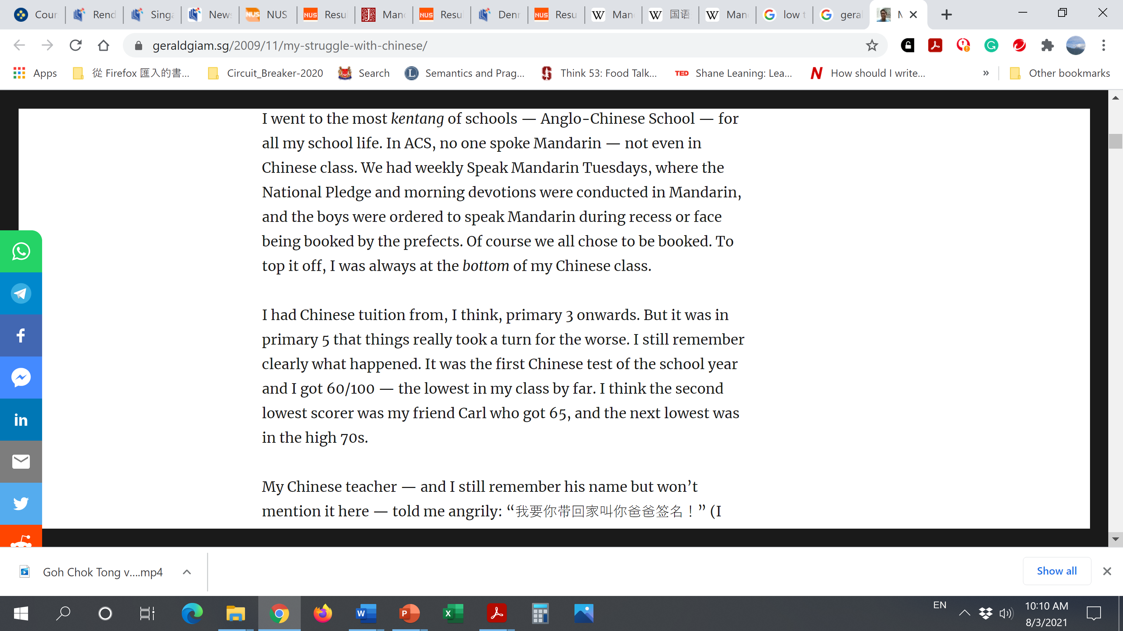

Slide 64
Bilingual Education

Slide 65
Key recommendations
Equal treatment of the 4 language streams
Promoting bilingualism or trilingualism based on the four official languages: English, Chinese, Malay and Tamil

Slide 66
The Report of the All-Party Committee of the Singapore Legislative Assembly on Chinese Education

Slide 68
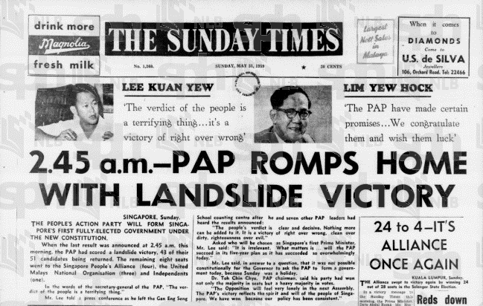

Slide 69
1960 onwards: 2nd Language

Slide 71
Chinese-medium and English-medium schools

Slide 72
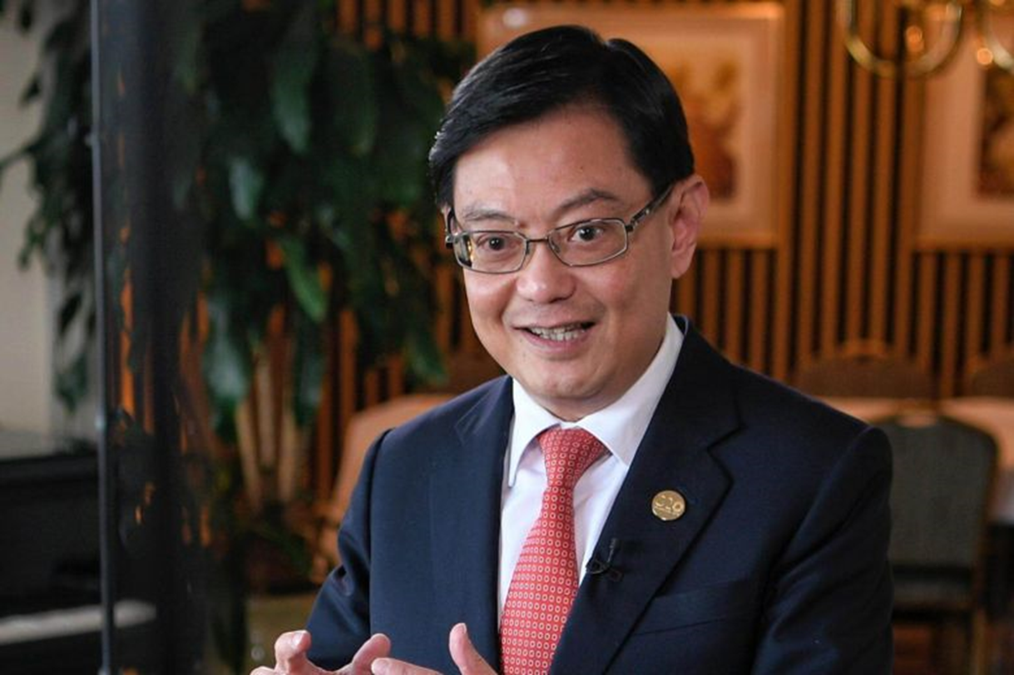
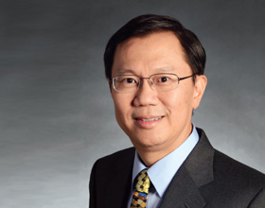
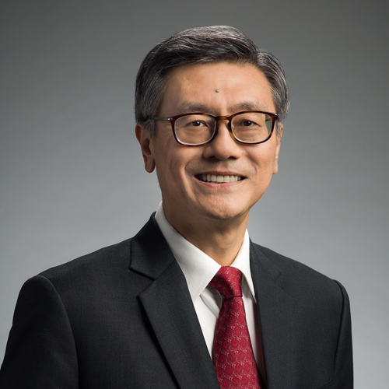
Born in the 1960s

Slide 73
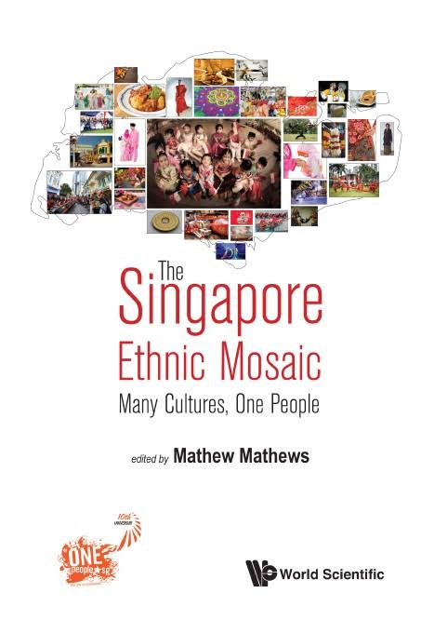

Slide 74
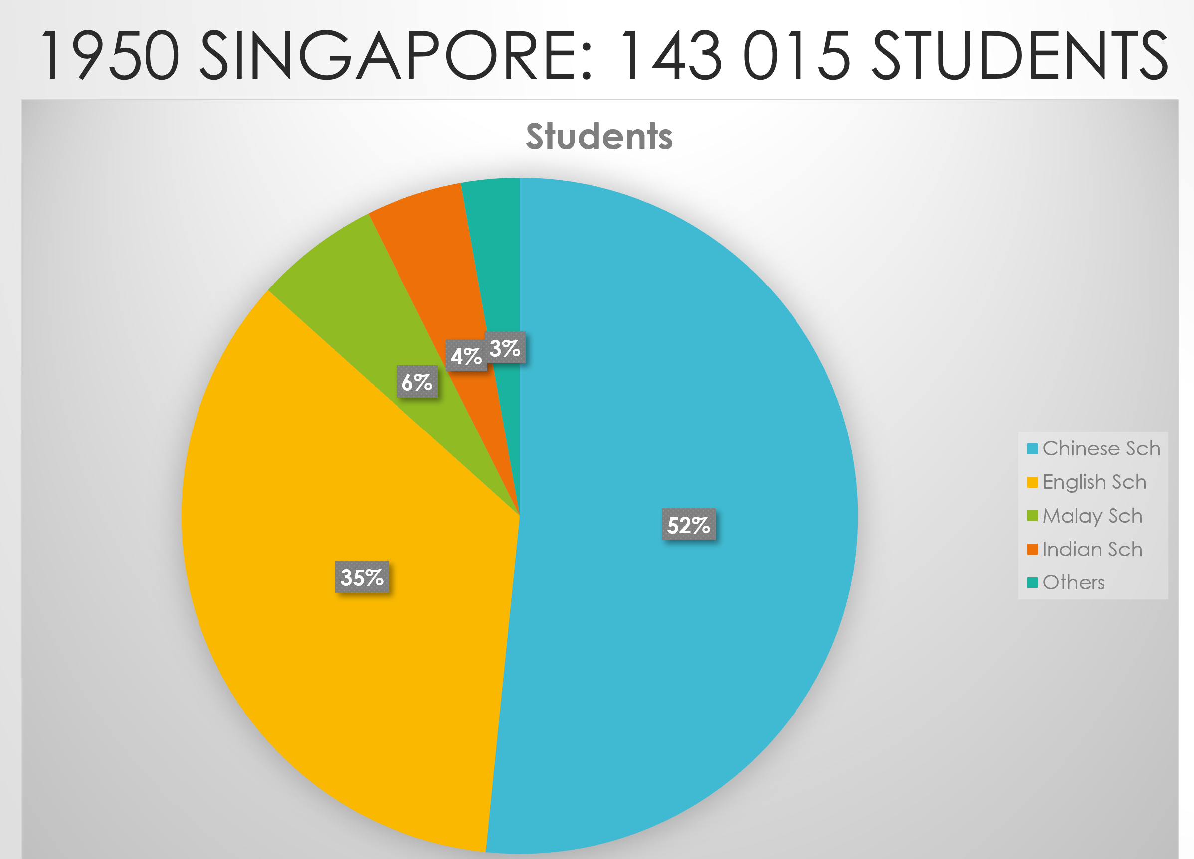

Slide 76
Chinese-medium and English-medium schools

Slide 78
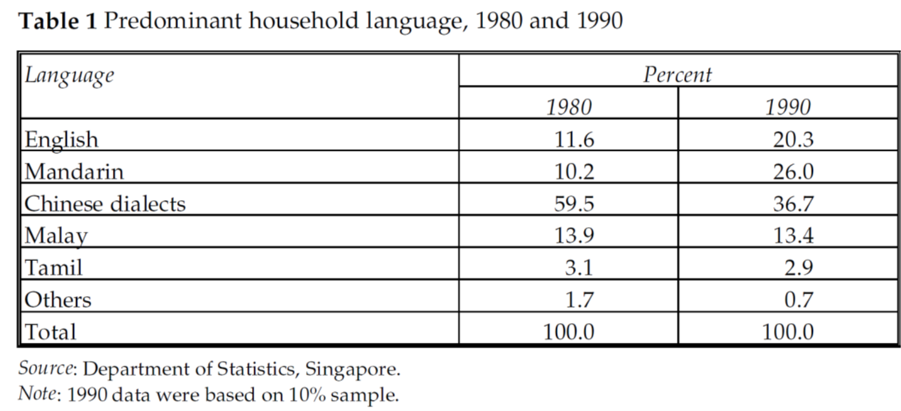

Slide 79
Report on the Ministry of Education (1978)
Goh Keng Swee (1918-2010)

Slide 81
Goh Report

Slide 82
The Problem

Slide 83
The conclusion
The bilingual policy was a failure as students found it very difficult to learn two languages proficiently, especially when 85% of them came from dialect-speaking homes where Mandarin was not spoken.

Slide 84
Bilingual research
Cummins (1979)

Slide 85
Revisiting our bilingual policy from the perspective of mother tongue-based schooling

Slide 86
1978
English as 1st language
Mother tongue
+
Mandarin as 2nd language

Slide 87
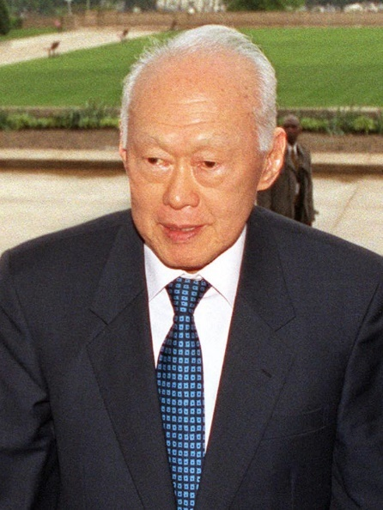

Slide 91
1978
English as 1st language
Mother tongue
+
Mandarin as 2nd language

Slide 92


Slide 95
What are the possible solutions?

Slide 96
Chinese as 1st language
Mother tongue
+
English as 2nd language

Slide 97
Streaming

Slide 100
Streaming in Secondary Schools
Special Stream
Express Stream
Normal Stream

Slide 101









SAP schools: The Big Nine (1979)

Slide 102
SAP schools
The Special Assistance Plan (SAP) was introduced in 1979 as a long-term scheme to preserve the best Chinese-stream schools so as to develop effectively bilingual students who were inculcated with traditional Chinese values. Nine Chinese-stream secondary schools were initially selected to serve as SAP schools.
The number of pupils enrolled in Chinese-medium schools continued to decline in the 1970s. Between 1960 and 1978, the proportion of pupils registered for Chinese primary schools fell from 39 percent to 10 percent.
During a forum on bilingual education in April 1978, then Prime Minister Lee Kuan Yew mooted the idea of transforming a number of top Chinese-medium secondary schools into bilingual schools.

Slide 103
Standard of Mandarin in the educational system was lowered

Slide 105
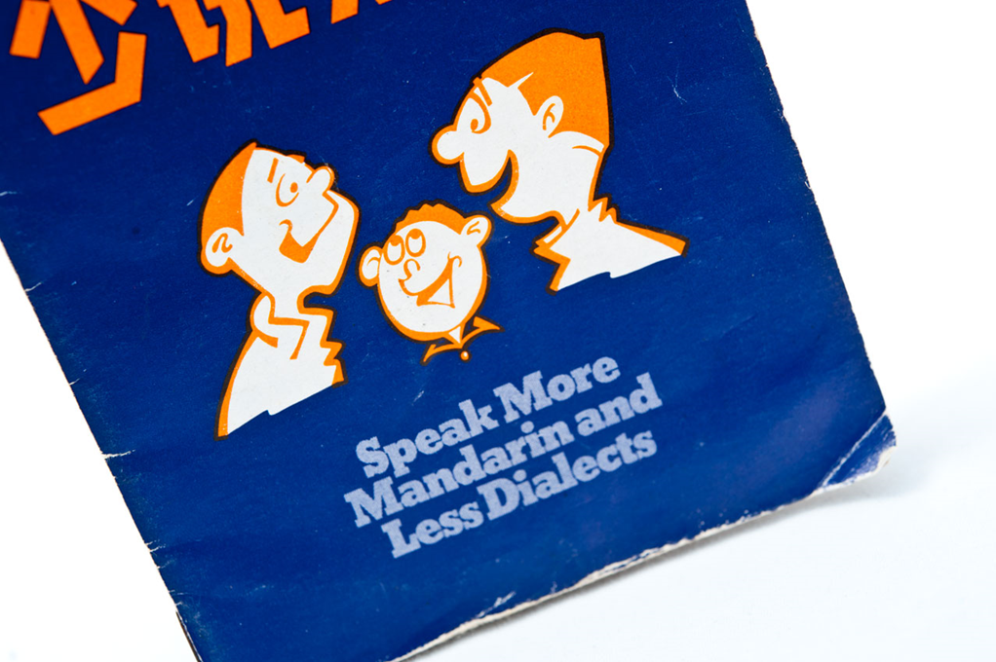

1979
The Speak Mandarin Campaign logo showing the profiles of two smiling faces that depicts two Chinese from different dialect groups understanding each other as they converse in Mandarin.

Slide 106
